Slide 1
MuscleHub AB Test
Lucas Stone
24/06/2018

Slide 2
Problem & Hypothesis Statement
The current process for on-boarding new members to the gym may not be optimal
Management suspects that there is a key pain point at which potential customers are being lost
Hypothesis: Removing the fitness test will mean more visitors to the gym will purchase a membership
Management would like to compare customer acquisition with and without this step as depicted below, by employing an A/B Test:
Suspected pain point
Proposed process (B)
Fitness test with personal trainer
Complete application for gym
Send payment for first month’s membership
Current process (A)

Slide 3
Summary of data sets and methodology
3 data sets were employed that contained the same personal data points along with the date the individual engaged with the gym in some way:
Visit date
Application date (where application was made)
Purchase date (where purchase was made)
These sets were combined into one containing all the engagement dates (some fields would be empty e.g. if an individual visited but did not apply) and filtered to include only visits within the A/B test period (on or after 7 – 1 – 17)
The two test groups were defined as those who were given a fitness test (A - 2504) and those who were not (B - 2500) – the two groups were of very similar size. The total data set was therefore 5004 individuals
A series of Chi-squared tests were employed because multiple (i.e. >2) categorical datasets were being compared – this test returns a p-value, which is an indication of the significance of the result

Slide 4
Hypothesis Test 1: Visit to application conversion
The number of applicants as a percentage of visitors per test group can be broken down as follows:
The p-value returned by the Chi-squared test was 0.000965. This is significant at the 0.05 level and therefore means that we reject the null hypothesis that there is no difference between the two test groups
This would suggest that the fitness test is having a slight but negative effect at the application stage – i.e. those that are allowed to skip the test are more likely to apply for membership
Test Group | Application | No Application | Total | Percentage Applications
A (fitness test) | 250 | 2254 | 2504 | 10%
B (no fitness test) | 325 | 2175 | 2500 | 13%

Slide 5
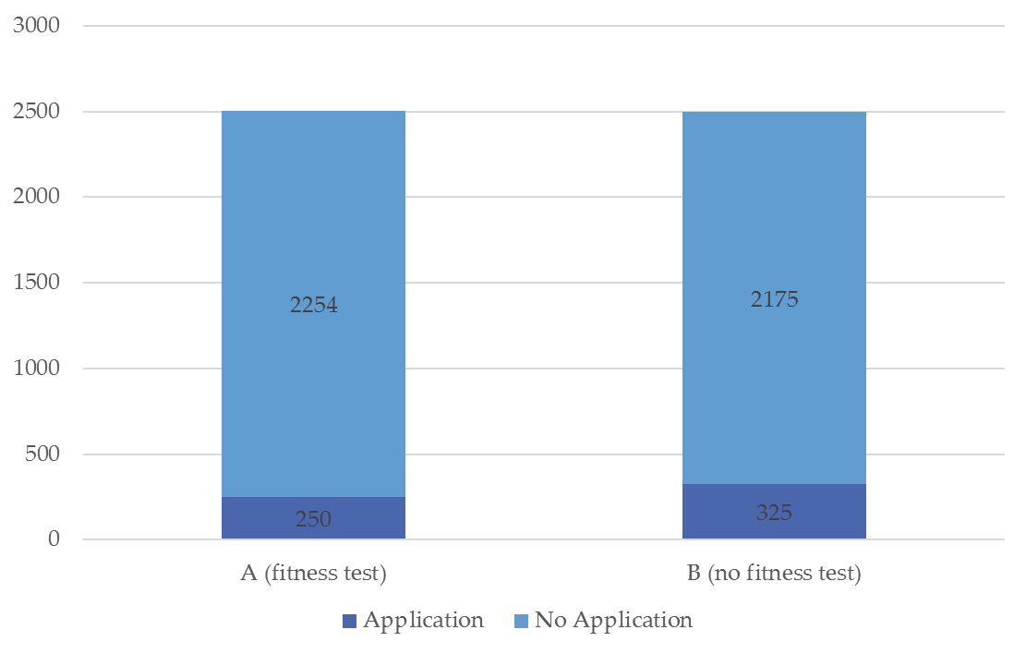
Hypothesis Test 1: Visit to application conversion
The graph below shows the slight but statistically significant negative effect the fitness test is having on visitors applying for membership:

Slide 6
Hypothesis Test 2: Apply to purchase conversion
The number of purchasing members as a percentage of applicants per test group can be broken down as follows:
The p-value returned by the Chi-squared test was 0.433. This is not significant at the 0.05 level and therefore means that we cannot reject the null hypothesis that there is no difference between the two test groups
This would suggest that once an individual has already applied, whether they carried out a fitness test does not impact the likelihood that they will continue on to purchase a membership
Test Group | Purchase | No Purchase | Total | Percentage Purchase
A (fitness test) | 200 | 50 | 250 | 80%
B (no fitness test) | 250 | 75 | 325 | 77%

Slide 7
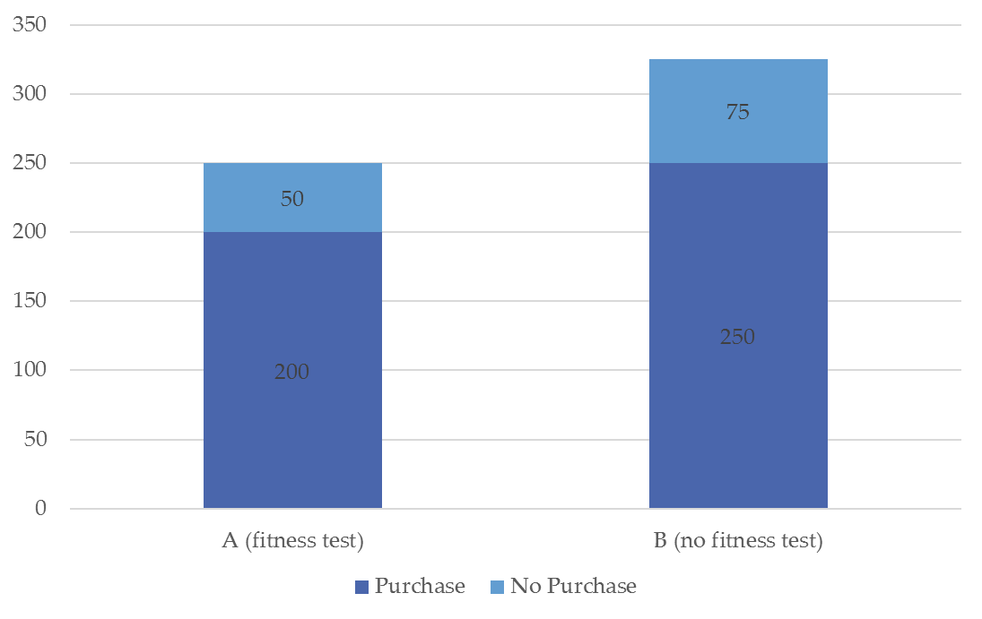
Hypothesis Test 2: Apply to purchase conversion
The graph below shows that the fitness test makes negligible difference to the purchase of a membership if an individual has already applied:

Slide 8
Hypothesis Test 3: Visit to purchase conversion
The number of purchasing members as a percentage of visitors per test group can be broken down as follows:
The p-value returned by the Chi-squared test was 0.0147. This is significant at the 0.05 level and therefore means that we can reject the null hypothesis that there is no difference between the two test groups
This would suggest that the fitness test impacts retention either at the application stage or the purchasing stage itself
Test Group | Purchase | No Purchase | Total | Percentage Purchase
A (fitness test) | 200 | 2304 | 2504 | 8%
B (no fitness test) | 250 | 2250 | 2500 | 10%

Slide 9
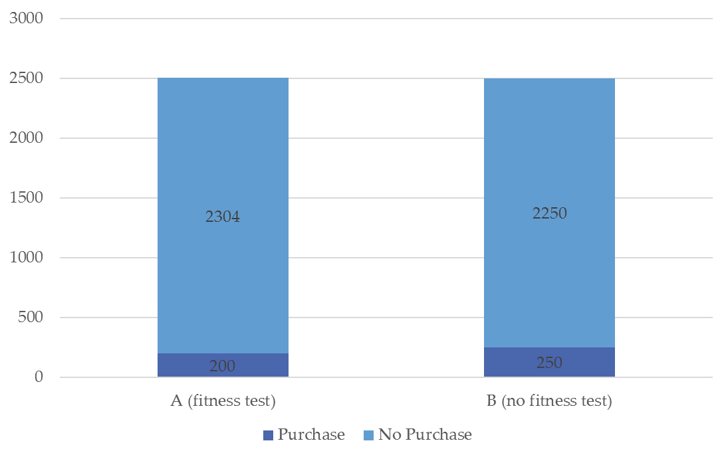
Hypothesis Test 3: Visit to purchase conversion
The graph below shows that the fitness test impacts the likelihood that an individual will purchase a membership:

Slide 10
Qualitative Data
The qualitative data gathered in the form of customer interviews aligns with the conclusions drawn from the data – i.e. that the fitness test is having a detrimental impact on the number of visitors who become members, and that potential customers are particularly being lost at the point of application
Some extracts that support this notion are as follows:
“When I walked into MuscleHub I wasn’t accosted by any personal trainers trying to sell me some mumbo jumbo”
“I took the MuscleHub fitness test because my coworker Laura recommended it. Regretted it.”
“I tried to sign up for LiftCity last year, but the fitness test was way too intense.”
However, one interviewee seemed to prefer having the fitness test (although this appeared to be the exception):
“MuscleHub’s introductory fitness test was super helpful for me!”

Slide 11
Summary of analysis
The results of the three hypothesis tests can be best summarized in the acquisition funnel below:
Process A
8% (of all visitors become members)
10% of visitors apply
80% of applicants purchase*
Fitness test with personal trainer (A only)
Complete application for gym
Send payment for first month’s membership
Process B
13% of visitors apply
77% of applicants purchase*
10% of all visitors become members
*Not statistically significantly different at the 5% level

Slide 12
Recommendations
Based on the results of the A/B test, MuscleHub should change the process by removing the mandatory fitness test
This is because the percentage of people who visit the gym and purchase membership is statistically significantly lower when they have to undertake the test (8%) compared to when they do (10%)
In particular, the step of the process where the individual applies seems to be when the effect manifests, since the percentage of people who apply for membership is similarly statistically significantly lower when they have to undertake the fitness test (10%) compared to when they do (13%)
Qualitative data in the form of interviews supports this assertion in regard to the fitness test repelling potential customers
The application step is by far the biggest pain point in terms of customer acquisition. Even after implementing this change – further analysis should be done to see how visitors can be encouraged to apply for membership

